Slide 1
IMPORTANT—FYI!!
Read the speaker notes—almost every slide has them and they contain TONS of info
  Not sure what a speaker note is? Hover at the bottom of the page and a double line should show up…or come to B116 for help.
Feel free to save a copy of this to your own computer or USB drive

Slide 2

Career Interview 101
Notes:
Do me a favor and take a second to think about something: What are you REALLY good at? Can you play an Instrument? Do you make a killer Pasta dish? Maybe you always beat your friends at chess...or dominate in video games.
Whatever you’re good at, you most likely got that way because you practiced, you did it over and over again until you gained confidence in yourself. Well, believe it or not, becoming really good in interviews is the same thing. Don’t worry. I’m not saying you have to go on a million interviews before you nail it.
But you have to practice, you have to work on getting to know yourself, and most importantly, you have to be prepared.
You’ve worked hard on your resume, made sure everything was perfect, even printed it on fancy paper. Then you walk into your first interview, hand your resume over to the nice lady behind the desk…and she glances at it, sets it aside, looks at you and says: So, tell me about yourself. What now? How many of you have felt unsure of how to answer these kinds of interview questions

Slide 3

Three Key Topics
Preparing for the actual interview
When you land the interview
After the interview

Slide 4
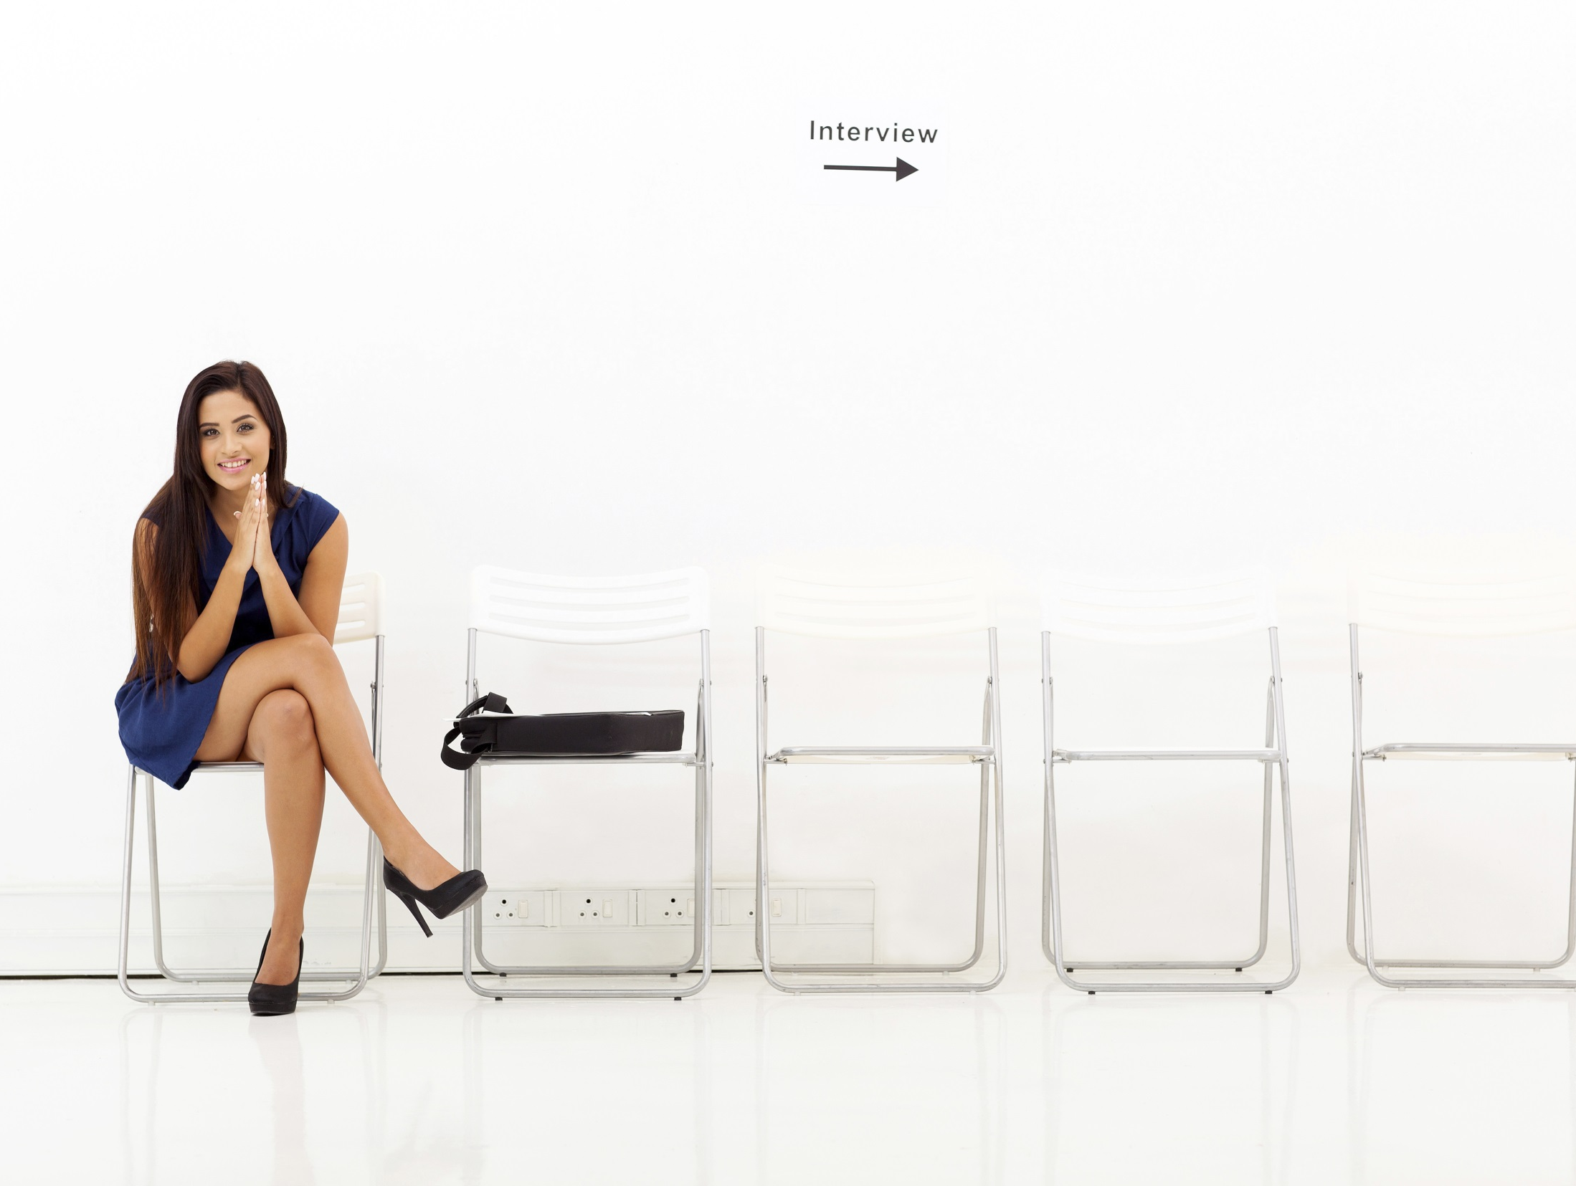
Interviewing
An Interview provides a chance for the potential employer to learn more about you, and for you to learn more about an employer. It’s simply a conversation between two parties.
Notes:
Let’s start with discussing what an interview is.
An Interview provides a chance for the potential employer to learn more about you, and for you to learn more about an employer. It’s simply a conversation between two parties.
Although the interview may be a stressful experience, consider it a form of recognition an opportunity to gain something valuable without risking anything but time. The can also be viewed as your audition...your tryout...your time to shine. Always keep the old adage in mind: You never get a second chance to make a first impression. That’s why it’s so critical that you prepare before the interview.
At this point the employer has reviewed your resume and is familiar with your qualifications. Employers are looking more at your “soft skills” such as interpersonal skills, teamwork, and professionalism. The interview allows you to showcase your communication skills by articulating the qualifications that you think make you the best candidate (Action hero) for the position and company.
Remember Employers are looking for a good fit- someone who has the right background and personality to blend in well with the company. Attitude and personality are just as important as qualifications. Be yourself, but be your “super” self. Preparation is the best, next step.

Slide 5
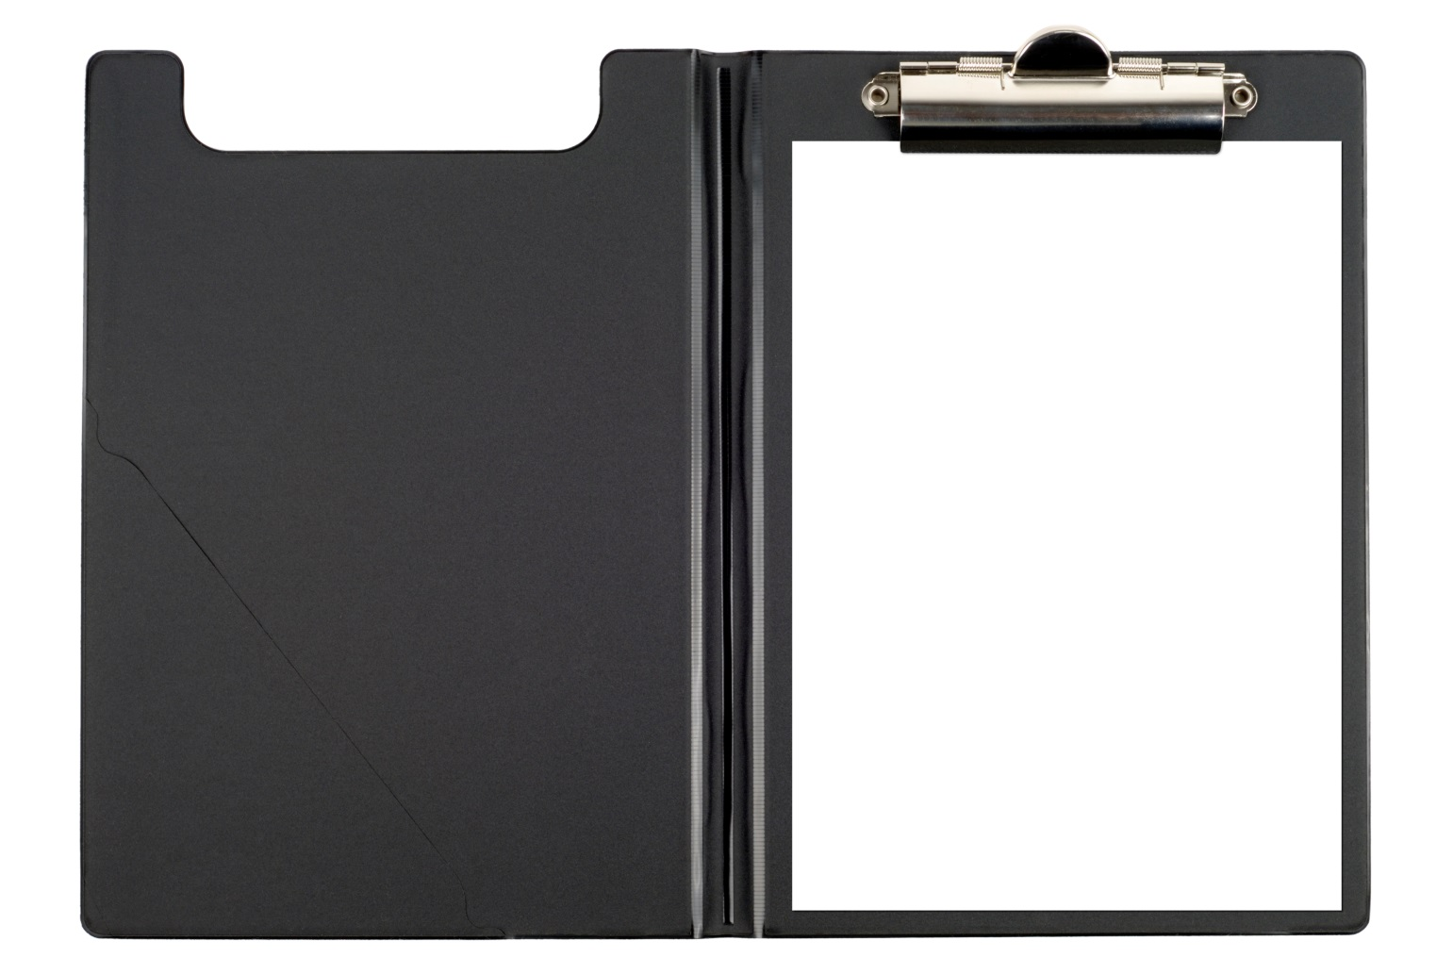
Before the Interview
Birth certificate
Social security card
Driver’s license/ID
Copies of your resume
Recommendations
Work permits
Job application
Pens
Paper to take notes
Job Search Folder
Notes:
Before the interview, preparing (or “prepping”) for the interview is just as important as the interview itself, and will help you feel relaxed and more confident during the actual interview.
There are some things that you can do to prepare…
One Suggestion is to prepare a job search kit. Collect a folder of things that may be needed. This is where a personal portfolio could come in very handy. Include the following:
Birth certificate
Social Security Card
Work Permit (if applicable)
Driver’s License
Several Copies of your resume
A copy of the job application (Why is this important?)
Letters of recommendation and/or references
Samples of Portfolio of Work (if applicable)
A black pen (in case forms need to be completed or a test is given)
Paper to take notes
“Consider this your career Portfolio”
You also need to know yourself--- Who are you?

Slide 6

Know Yourself
Spend some time reviewing your qualifications and accomplishments .
Get to know your personal attributes and skills by taking a self assessment.
Think about your career goals. Where do you see yourself down the road?
Notes:
How well do you know YOU? Selling yourself can be tough, but a good way of thinking about it is: If you were a product, what would be your top selling points?
For example, if you were a Honda, your top selling point might be safety. With that in mind, if you are good at fixing things what would be your
selling points?
Example: your biggest selling point might be that you’re extremely detailed oriented.
Write down your qualifications; list your skills and personal attributes. Then, try to match your skills and attributes to the position. This will help you determine if you’re a good fit for the job, and it’ll be easier for you to sell yourself during the interview. Also, make sure you rehearse talking about your skills and attributes out loud. The more you practice, the more comfortable you’ll become tooting your own horn.

Slide 7

Research the Company
Notes:
Just think, the more knowledge you have about the company and the position you’re applying for, the more you’ll impress your
potential employer. The trick is to research, research, and research.
Start with the easiest source for information and read through the company’s website. That’s the best place to start...but what other ways can you research a company?
Check out the company’s Twitter feed and Facebook page. If you know who you’re going to be interviewing with, look them up on LinkedIn.
Of course, you can find great information off line, too. Go to the library and research any industry publications you can find.
Take what you learn and prepare questions you can ask during the interview. It shows you’ve done your homework and you’re serious about wanting to work for the company.

Slide 8

Making a Lasting Impression
Most experts agree that 80 percent of an interviewer’s opinion of a candidate is based solely on his or her first impression.
80%
Notes:
Dress for Success
Most experts agree that 80 percent of an interviewer’s opinion of a candidate is based solely on his or her first impression. We all know that first impressions are lasting ones.
Being prepared also applies to your appearance. It’s important that you present yourself as a professional and know what you’re going to wear days before the interview.
Keep in mind- dress for the industry that you are applying for. If you are applying for a construction position you may not feel comfortable showing up in a 3 piece suit.

Slide 9

How to Create Presence
General Business Attire for Men
A two piece, conservative suit in a dark color– navy, black, or gray
A white or blue long-sleeved, button-down dress shirt (an undershirt is a good idea)
A coordinating neck tie with a subtle pattern
Dark socks that cover your leg when you sit down– not white athletic socks
Dark leather shoes
Notes:
Guys, a sharp suit is a must for any job seeker. Make sure it fits properly—borrowing your brother’s suit is probably not the best option. Polish your shoes and depending on where you’re interviewing, putting on a tie is a nice touch.

Slide 10

How to Create Presence
General Business Attire for Women
A two-piece, conservative pant or skirt suit in a neutral color- black, gray, navy, or brown
Choose a classic cut suit with knee–length skirt
Closed-toe, moderate-heeled (1” -2” shoes)
Avoid heavy make up and extremely long fingernails; nail polish should be a neutral color
Notes:
Ladies, a nice business suit is a great choice for you, too. Stick to neutral colors like black, grey, navy blue and don’t wear a skirt that’s too short. You can add accessories and wear makeup but nothing too flashy—keep it simple.
This one is true for guys and gals: be sure to cover up tattoos and remove facial piercings. They can be distracting to the interviewer. (Depending on where you are interviewing).

Slide 11

More Interview Tips
Be on time
Avoid strong fragrances
Less is more
Turn your cell phone off
Clean up your social media
Treat everyone respectfully
Do not talk negatively about past employers
Bring extra copies of your resume and your references
Notes:
Avoid Strong Fragrances- Wear deodorant, but don’t wear perfume, cologne, or aftershave. The interviewer may not have the same taste as you, and you don’t want to overpower the room.
Less Is More – Keep your look simple. Wear minimal jewelry and no visible body piercings and tattoos.
Be on Time- Don’t start your interview off on the wrong foot. Get there at least ten minutes early. By doing these things to ensure you arrive on time, you’ll take a lot of the stress out of your interview day.
Clean up your Social Media-
Treat everyone with whom you come in contact with ,with respect- The secretary or security guard could have some say in you getting hired.
Do not talk negatively about past employers or positions.
Work on your body language- During interviews, your body language can say more about you than your words. When you introduce yourself, give a strong handshake and smile. Exude confidence, be excited that you’re there and your positive attitude will definitely rub off on the interviewer.

Slide 12
Sample Interview Questions
Tell me about yourself.
Keep your answer brief and concise (60-90 seconds). Highlight your academic background, work experience, and personal attributes that are relevant to the position. Express your enthusiasm for the position and your desire to work for the company.
Why do you want to work for this company?
Tell a story about how you first became interested in the type of work. Point out how your previous experience shows a long term interest in the industry. Express your passion for your work.
Notes:
Its normal to be nervous during an interview. Take a deep breath and keep the tone conversational. Find a balance between listening and speaking.
Tell me about yourself
What this question is really asking is: Tell me how your professional experience and skills make you a good candidate for the job. Prepare an answer that matches your qualifications with what you think the interviewer is looking for based on the job description. Students this can be an interview stumper, so don’t ramble, and don’t get too personal. Talk about who you are as it relates to the position you are applying for.
Why do you want to work for this company?
For example, if you’re applying for an IT position, you’d tell a short story about how you fell in love with computers. This is also the perfect time to bring up some of the research you did on the company: “I read that Company ABC has several green initiatives and I’m a big believer in protecting the environment, too. It’s just another reason this seems like a great place to work.” And again, be energetic about the opportunity!

Slide 13
Sample Interview Questions
Where do you see yourself in 3-5 years?
Your answer should reflect your interest in staying involved with the company so the employer knows that you are in good investment. Having a future goal demonstrates motivation and focus.
What qualifications do you have that will make you successful in this position?
Be specific. Remember to use examples of how you have demonstrated two or three skills in your previous experience.
Notes:
Where do you see yourself in 3-5 years?
Your answer should reflect your interest in staying involved with the company so the employer knows that you are a good investment. Having a future goal demonstrates motivation and focus.
What Qualifications do you have that will make you successful in this position?
Be specific. Remember to use examples of how you have demonstrated two or three skills in your previous experience. (Every interview question is an opportunity to market their skill sets, so take advantage of it).

Slide 14
Sample Interview Questions
Describe your working relationship with your colleagues?
The employer is trying to gauge your interpersonal skills. Emphasize your ability to fit in with many different personality types and your willingness to be a part of the team.
What is one thing you need to work on?
Be honest, but put a positive spin on it. Recognizing your limitations show maturity. Tell the employer what you have learned from your experience and how you have already worked to improve this shortcoming.
Notes:
Describe your working relationship with your colleagues?
The employer is trying to gauge your interpersonal skills. Emphasize your ability to fit in with many different personality types and your willingness to be a part of the team.
What is one thing you need to work on?
Be honest, but put a positive spin on it. Recognizing your limitations show maturity. Tell the employer what you have learned from your experience and how you have already worked to improve this shortcoming.

Slide 15
Sample Interview Questions
Tell me of a time when you received constructive criticism? What was it and how did you handle it?
This is a behavioral based question. The interviewers will ask you to describe a specific example of a past behavior in order to predict future behavior.
.
Notes:
**Tell me of a time when you had to work under intense pressure to meet a deadline? **
In this case the interviewer wants you to describe an actual situation using specific details, how you handled the situation, and the outcome of the situation.
Practice your answers to these questions, over and over again. Say them out loud. Do it in front of friends and family. Like I mentioned earlier, the more you work on branding yourself, the easier it gets.

Slide 16

Notes:
When the interviewer asks, do you have any questions for me? You should have some ready because it demonstrates your interest in the job and your knowledge about the company. Stay away from questions about salary, benefits and vacation time until they make you an actual offer….then the HR department should answer those questions, if not, then ask—politely.
What are some examples of the kind of questions you should ask during an interview?
1. What would you say are the 3 most important skills needed to excel in this position?
2. What does a typical day or week look like for the person in this position?
3. How can I best contribute to the department?
Doing your research of the company can help you formulate a few good questions for the interviewer.

Slide 17

After the Interview…
Notes:
At the end of an interview, clarify any follow-up procedures such as the hiring time line and any additional materials they may need. Reiterate your qualifications and your fit with the position and/or company. Be direct and state your interest in the position. Remember to smile and leave them with a positive felling about your interview.

Slide 18

Follow up
Notes:
Hey, you survived the interview! The tough part may be over, but there are still a few things you can do to increase your chances of landing the Position.
Fewer than half of candidates send a follow-up letter. Sending a thank-you letter is not only professional and polite, but it could give you the edge that sets you apart from other candidates.
BE SURE TO GET A BUSINESS CARD OF THE PERSON OR PERSONS WHO INTERVIEWED YOU so you will have the correct spelling of names when sending a thank-you note.

Slide 19

Inappropriate
Questions
Age
Race, ethnicity of color
Gender or sex
Country of national origin or birth place
Religion
Disability
Marital, family, or pregnancy status
Notes:
Most professional interviewers are trained to ask only those questions that relate to the applicants ability to do the job. However, you should be aware of your rights as an applicant if asked one of the following questions.
When faced with an inappropriate/personal question , you essentially have three choices:
Answer the question, assuming you don’t mind sharing the information.
Refuse to answer the question, knowing that you may risk appearing uncooperative or confrontational.
Answer the underlying job related question;
Example
QUESTION- “Are you planning to have a family?
INTENT- “Are you willing to travel or relocate?”
ANSWER- “ I am committed to my career and willing to travel or relocate if needed”
OR
“ My decision to have a family will not affect me conducting the duties of this position”.

Slide 20
Were You Rejected For One Of The Following Reasons?
Lack of clear career goals and purposes
Inability to express information clearly
Failure to show confidence or poise; eye-contact
Poor personal appearance
Asking uninformed questions about the job or company
Sloppy application form
Arriving late for the interview
Notes:
Someone else got the job you really wanted. This is disappointing; however, remember that most people receive more “no” responses than “yes” responses when seeking a job.
There will be times when you feel like you did everything right and still don’t get a job offer. It could be because you simply weren’t
qualified enough, or another candidate had more experience—things completely out of your control. But according to Forbes, hiring managers say these are the most common ways job hunters shoot themselves in the foot.
1. Lack of clear career goals and purposes. Or maybe you have chosen the wrong goal.
2. Inability to express information clearly
3. Failure to look interviewer in the eye; no confidence or poise
4. Poor personal appearance
5. Asking uninformed questions about the job or company
6. Unwilling to start at the bottom
7. Sloppy application form
8. Arriving late for the interview
A few additional talking points….. (not listed on the slide)
1. Not hearing from you makes the interviewer think you’re not interested.
2. Again, back to research: If you don’t know anything about the company, it shows.
3. If you are too focused on moving up and not interested in the job at hand, it could mean you won’t be satisfied with the entry level position.
4. Even if you’ve been laid off, or had to quit because of a family member’s illness, don’t act like only bad things happen to you. Being too
negative is a big turn off.
5. Body language...we already talked about “walking the walk.”
6. Even if you’ve had bad experiences with past co-workers, don’t complain about them in the interview. Could make it seem like you’re hard to work with.
7. Be confident in your abilities and your work. Interviewers like people who know their worth.

